Slide 1
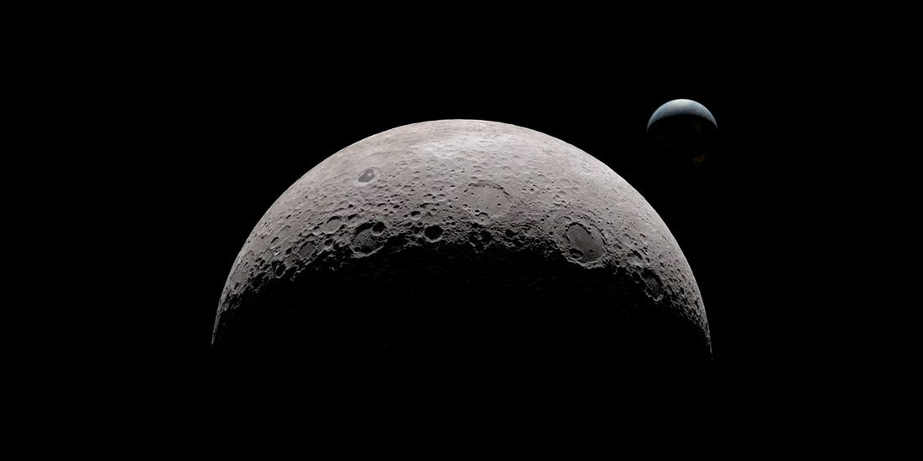
NASA Self-Leveling System
EML 4551
Team 516:
Stephen Brown
James Evans
Dalton LeClair
Jake Seaman
Parker Stensrud

Slide 2













Team Introductions
Stephen Brown
Materials Engineer
James Evans
Design Engineer
Dalton LeClair
Test
Engineer
Jake Seaman
Systems Engineer
Parker Stensrud
Controls Engineer
Dalton LeClair

Slide 3
Team Introductions
Stephen Brown
Materials Engineer
James Evans
Design Engineer
Dalton LeClair
Test
Engineer
Jake Seaman
Systems Engineer
Parker Stensrud
Controls Engineer
Dalton LeClair

Slide 4




Sponsor and Advisor
Project Sponsor
Rachel McCauley
NASA Marshall Space Flight Center
Faculty Advisor
Dr. Dorr Campbell
FAMU-FSU College of Engineering
Dalton LeClair

Slide 5






Project Background
Dalton LeClair

Slide 6
Project Scope
The objective of our project is to provide a level working environment for the astronauts aboard the lunar lander.
Dalton LeClair

Slide 7







Dalton LeClair

Slide 8

Project Goals
Level Within an Hour
Leveling Capabilities up to 12-Degree Slope
Reusability
Supports 14-16 Metric Tons
Dalton LeClair

Slide 9

Environmental Challenges
Sand-blasting due to regolith
Coefficient of thermal expansion
Cold Welding
Radiation
Dalton LeClair

Slide 10
Leveling Functions
Sense
Power
Lander
Motion
Dalton LeClair

Slide 11

Concept Generation
Dalton LeClair
Notes:
Remember to say that all the concepts get information from the onboard IMU during the presentation

Slide 12

Medium Fidelity
Three-Legged Tripod
  Whole leg design
  Integrated into the landing gear
Slider System
XY translation of the lander cabin to move the center of mass until level
Second Landing Gear
Compact until deployed
Multiple arms to lift the lander until level
Gas Release
Piston Cylinder Assembly
Compressed gas in cylinder is released to level
Rack and Pinion
Allow to move upward and downward
Can be fine-tuned
Dalton LeClair

Slide 13
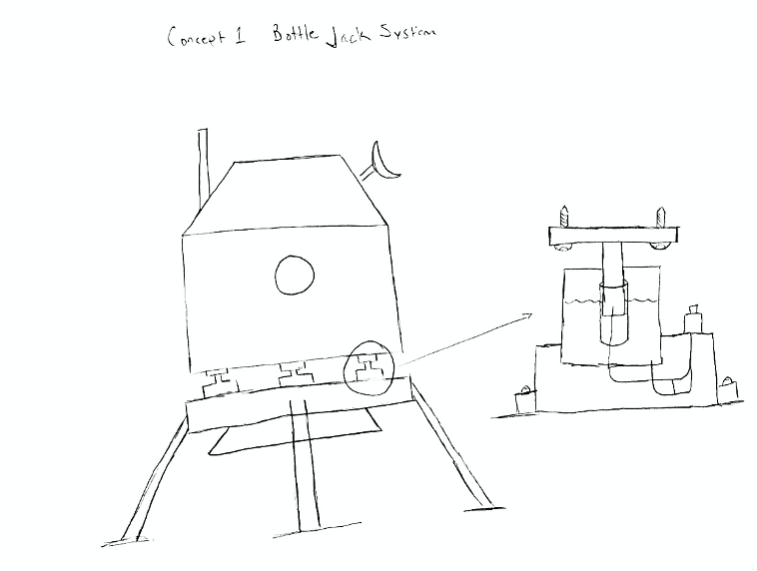
High Fidelity
Bottle Jack System
  Begin fully extended
  Use hydraulics to lower until level
  Mechanism will be isolated from the elements
Parker Stensrud

Slide 14
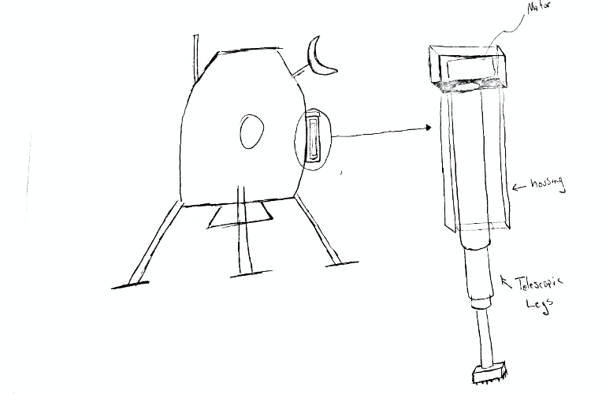
High Fidelity
Telescopic Legs
  Secondary legs not used for landing
  Four (4) housings containing retracted legs and motor to extend them
  Housing will have brush like bottom to dust off legs upon retraction
Parker Stensrud

Slide 15
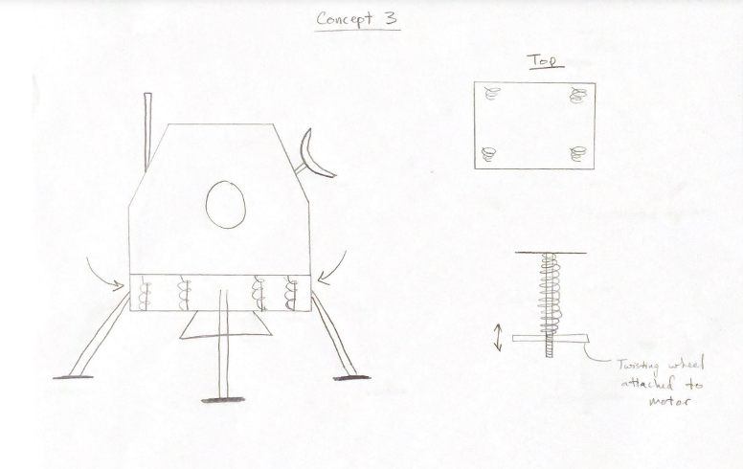
High Fidelity
Spring System
  Begin fully extended
  Springs will be tightened via motors and lowered until level (operates like 3D printer bed)
  Mechanism will be isolated from the elements
Parker Stensrud

Slide 16

Concept Selection
Parker Stensrud

Slide 17
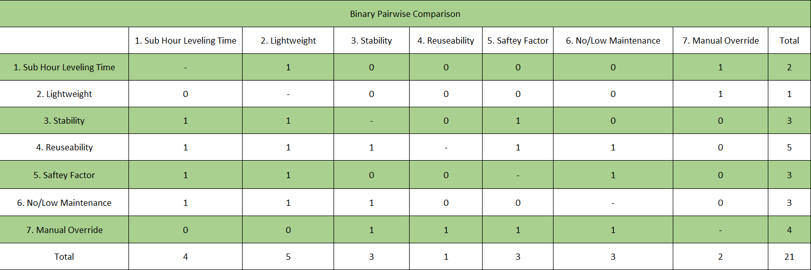
Binary Pairwise Comparison
Parker Stensrud
Notes:
customer requirements on both axis.

Slide 18
Binary Pairwise Comparison
Parker Stensrud
Notes:
These are customer requirements . Used to get importance weight factor

Slide 19
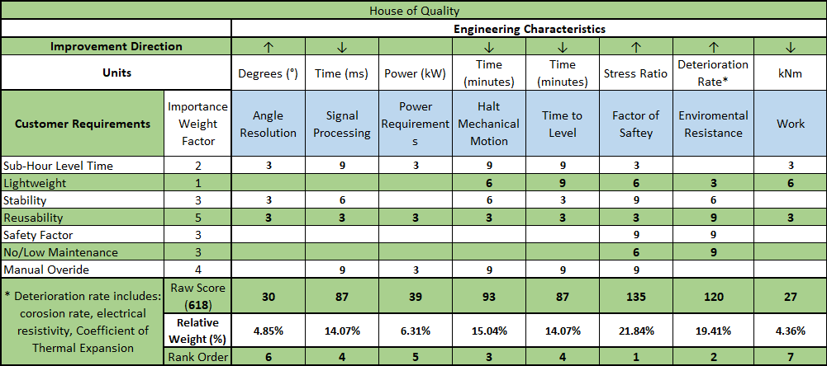
House of Quality
Parker Stensrud

Slide 20
House of Quality
Parker Stensrud

Slide 21
House of Quality
Parker Stensrud
Notes:
engineering characteristics are derived from the functional decomposition

Slide 22
House of Quality
Parker Stensrud

Slide 23
Concepts
Datum(slider)
Rack and pinion
Secondary landing gear
Bottle Jack
Gas System
Telescopic legs
Spring System
Tripod
James Evans

Slide 24
Concepts
Datum(Tripod)
Spring System
Rack and pinion
Bottle Jack
Gas System
James Evans

Slide 25
Final Three Concepts
Spring System
Bottle Jack
Gas System
James Evans

Slide 26
Analytical Hierarchy Process
James Evans
19

Slide 27
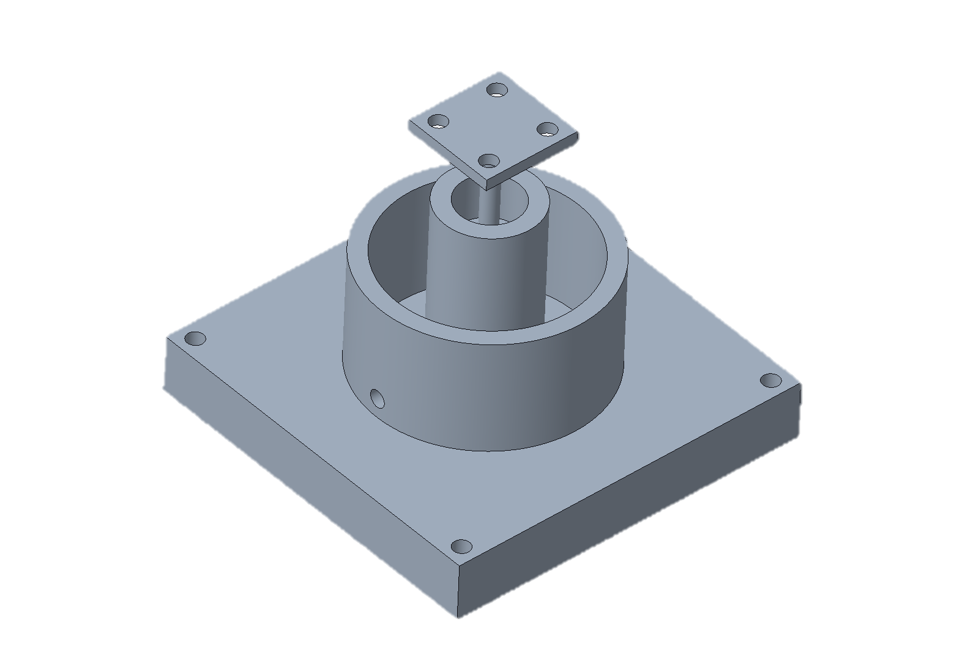

Bottle Jack Hydraulic System
  Environmental concerns
  Low maintenance
  Good reusability
  Team assumptions
  Ball Joint near the hydraulic press point
James Evans

Slide 28

Future Work
CAD Models
Computer Simulations
Material Selection
Testing
Build Scale Model
Current Stage
James Evans

Slide 29








NASA Self-Leveling System
EML 4551
Team 516:
Stephen Brown
James Evans
Dalton LeClair
Jake Seaman
Parker Stensrud

Slide 30
Reference
Williams, M. (2018, August 22). What is Lunar Regolith? Retrieved October 11, 2020, from https://www.universetoday.com/20360/lunar-regolith/
Curiosmos Send an email, Curiosmos, & Email, S. (2020, March 09). Why Artemis? 5 Things You Should Know About NASA's 2024 Manned Moon Mission. Retrieved October 11, 2020, from https://curiosmos.com/why-artemis-5-things-you-should-know-about-nasas-2024-manned-moon-mission/
Potter, S. (2020, April 30). NASA Names Companies to Develop Human Landers for Artemis Missions. Retrieved October 10, 2020, from https://www.nasa.gov/press-release/nasa-names-companies-to-develop-human-landers-for-artemis-moon-missions
Mosher, D. (2018, November 30). NASA's first moon landings in nearly 50 years may happen in 2019. The agency thinks these 9 companies can get it to the lunar surface. Retrieved October 12, 2020, from https://www.businessinsider.com/nasa-moon-landing-mission-private-competition-2018-11
Thread: Cold welding GIF. (n.d.). Retrieved October 13, 2020, from https://www.homemadetools.net/forum/cold-welding-gif-56268
Apollo-Animation [.mpg]. (2020, October 08). NASA.

Slide 31
Future Work
CAD Models
Computer Simulations
Material Selection
Testing
Build Scale Model
James Evans

Slide 32
Backup Slides

Slide 33
Pugh Matrix
James Evans

Slide 34
Pugh Matrix
James Evans

Slide 35
Pugh Matrix
James Evans

Slide 36
Pugh Matrix
James Evans

Slide 37
Self-Leveling System
Lander
Motion
Sense
Power
Angle
Transform Electricity Into Mechanical Motion
Identify Angle Offset
Translate
Transform electricity into mechanical motion
Translate Power
Receive Power
Recognize Signal
Detect Signal
Process Signal
Identify Signal
Distribute Signal
Stabilize
Halt Mechanical Motion
Level
Transform Electricity Into Mechanical Motion
Identify Angle Offset

Slide 38
Customer Needs
Questions | Response | Interpretation
1. What do you like about the current lander leg systems? | We like the stability and weight. | The design needs to keep the stability and weight of previous lander legs in mind.
2. What do you dislike about the current lander leg systems? | It does not self-level. | The design is to have self-leveling capabilities.
3. What part of the landing mechanism is our team responsible for? | We planned on you designing the legs and ground contact points. | The team is to design the legs and contact point with the landing surface.
4. Are we limited to a certain material? | No, however the materials used must have X specific properties. | The team is to select a material that meets specified properties.
5. What is the maximum mass that the legs will be supporting? | 15,000 kg in earth's gravity (weight of the Apollo moon lander) | The legs are to support a maximum weight of 15,000 kg on Earth.
6. What scale are we designing to? | The model should be parametric which allows for variable scale. | The CAD will be done parametrically.

Slide 39
Customer Needs
7. What software should our team simulate in? | Industry friendly that allows for easy sharing. | The team will use the software of their choice.
8. How detailed would you like the simulation to be? Fully/Partially Animated etc. | The function of the self-leveling system must be fully animated but other parts can be partially animated. | The team is responsible for a detailed simulation of the self-leveling system.
9. What lander platform should we be designing for? | The system should be able to be applied onto various lander models. | The self-leveling system needs to be able to be applied to different lander models.
10. Do the legs need to be stored away while not in operation? Do they need to be secured? | No. | The legs can be rigidly attached to the lander.
11. What will the system be powered by? | It will have a common power source with the rest of the lander. | The team is not responsible for designing a power system.

Slide 40
Customer Needs
12. Do we need to be worried about the time it takes for the legs to level? | Yes, it should at maximum take 2 minutes. | The legs are to level the lander within 2 minutes of landing.
13. Do we need to be worried about clearance under the lander? | Yes, there need to be at least 1 meter of clearance. | There is to be a minimum clearance of 1 meter above the landing surface.
14. Does the leveling need to occur upon landing or during approach? | The leveling process will start upon landing. | The self-leveling process is to begin upon landing.

Slide 41




Market
Primary
Secondary
NASA Marshall Space Flight Center (MSFC) Advanced Concepts Office (ACO)
European Space Agency
SpaceX
Blue Origins
Virgin Galactic
Department of Defense
Stephen Brown

Slide 42
Functional Decomp Backup

Slide 46

Stephen Brown

Slide 47

Major Takeaways
The astronauts need a level working environment inside the lander
The design will be influenced by:
  Environment
  Materials
  Reusability
  Team Assumptions
Jake Seaman

Slide 48
Functional Decomposition: Cross-Reference Table
Function | Motion | Power | Sense | Lander
Angle | X |  | x
Transform Electricity into Mechanical Motion | X | X |  | X
Identify Angle Offset | X |  | X | X
Translate
Translate Power | X | X
Receive Power |  | X |  | X
Recognize Signal |  |  | X
Identify Signal |  |  | X
Detect Signal |  |  | X
Process Signal |  |  | X
Output Power |  | X
Stabilize | X |  | X | X
Halt Mechanical Motion | X |  |  | X
Level | X |  | X | X

Slide 49
Team Introductions
Stephen Brown
***Engineer

Slide 50
Team Introductions
Stephen Brown
***Engineer
James Evans
***Engineer

Slide 51
Team Introductions
Stephen Brown
***Engineer
James Evans
***Engineer
Dalton LeClair
***Engineer

Slide 52
Team Introductions
Stephen Brown
***Engineer
James Evans
***Engineer
Dalton LeClair
***Engineer
Jake Seaman
***Engineer

Slide 53
Standard Shapes
Summary Box
Text box 1
Outlined Text Box

Slide 54




Approved Logos

Slide 55
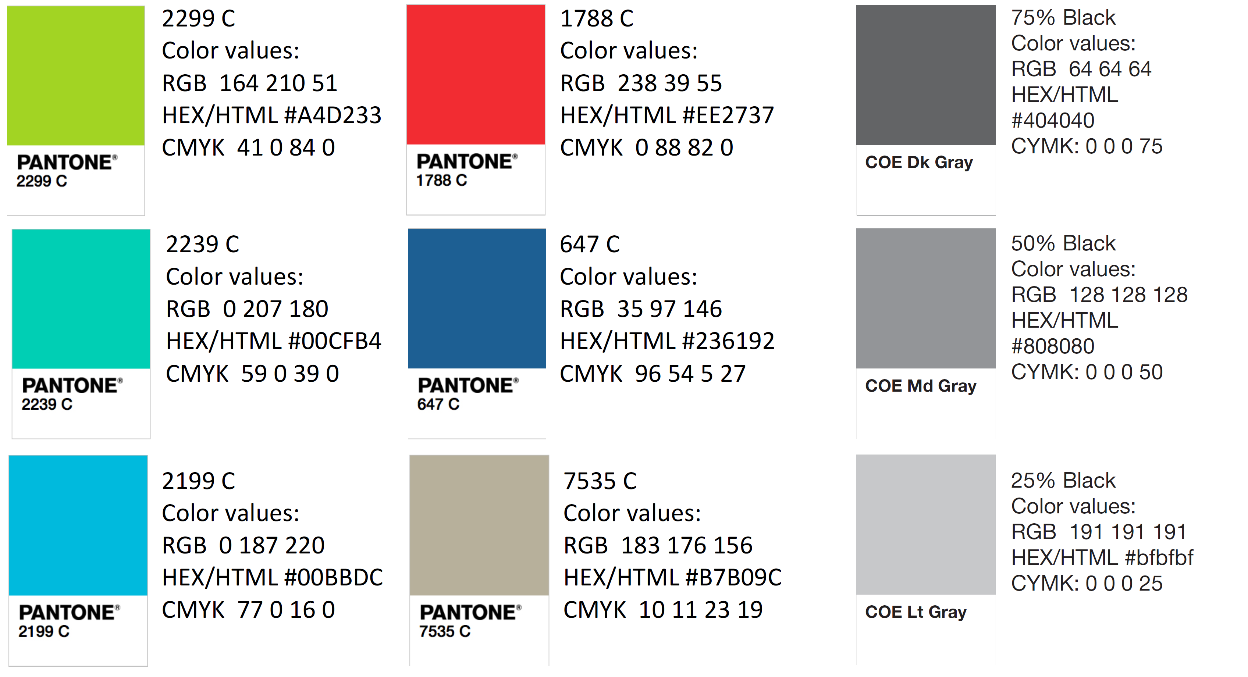
Color Palette

